Slide 1
Fuzzy Logic Based Image Quality Control in Low Light Situations
Laptop
webcam
Arduino
LED
Student: Chia Sheng Kuo
Adviser: Prof. Chi Cheng Cheng
Dept. of Mechanical and Electro-Mechanical Engineering National Sun Yat-Sen University

Slide 2
OUTLINE
Brief introduction to AE
System Specification
Input & Output
Environment Test
Fuzzification
Fuzzy Inference
Defuzzification
Result & Conclusion

Slide 3
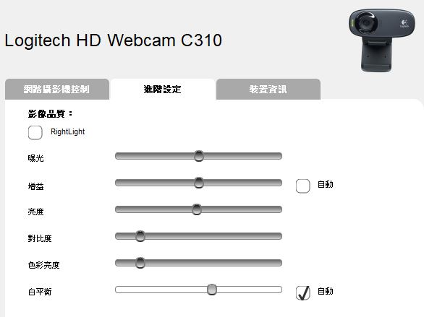
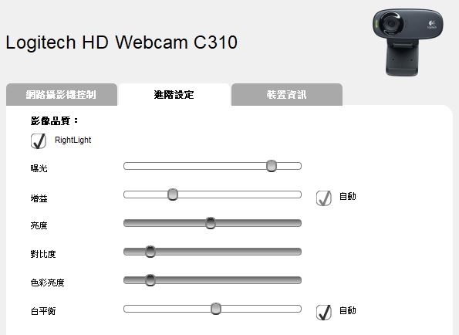
Auto Exposure
In low light situation, even AE is applied, image quality could be degraded.
That’s the reason why camera needs the flashlight.

Slide 4
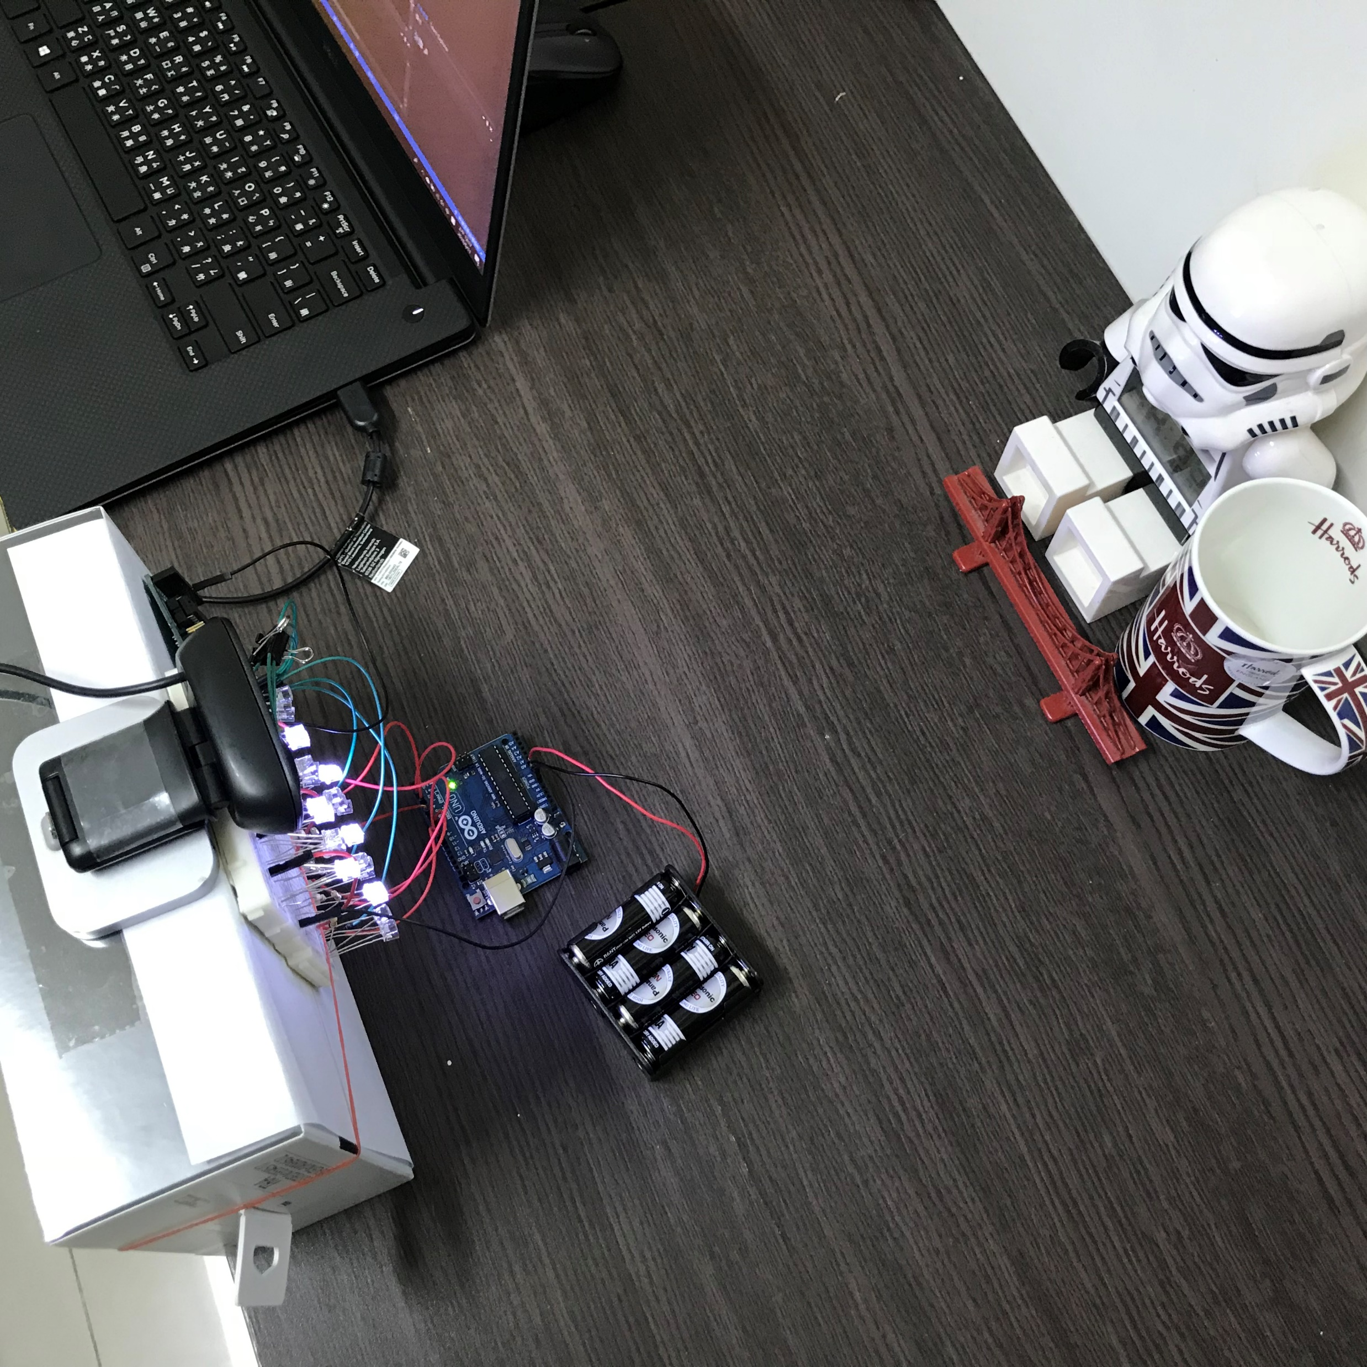
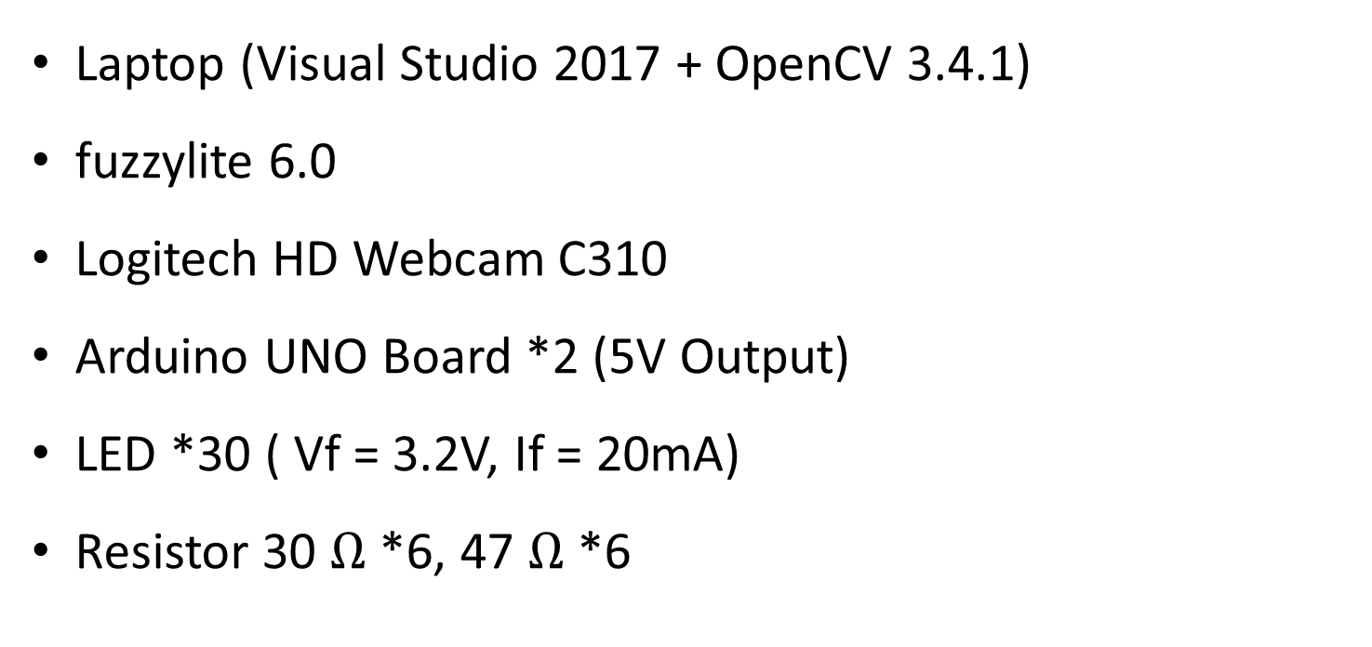
Specification
Laptop (Visual Studio 2017 + OpenCV 3.4.1)
fuzzylite 6.0
Logitech HD Webcam C310
Arduino UNO Board *2 (5V Output)
LED *30 ( Vf = 3.2V, If = 20mA)
Resistor 30 $Ω$ *6, 47 $Ω$ *6

Slide 5
Input
Fuzzification
Inference
Defuzzification
Output

Slide 6

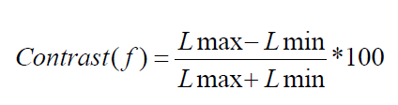
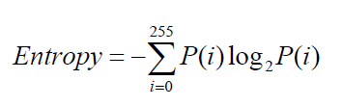
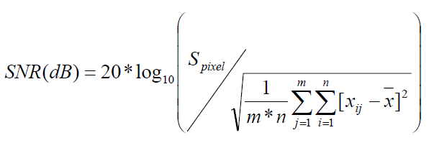
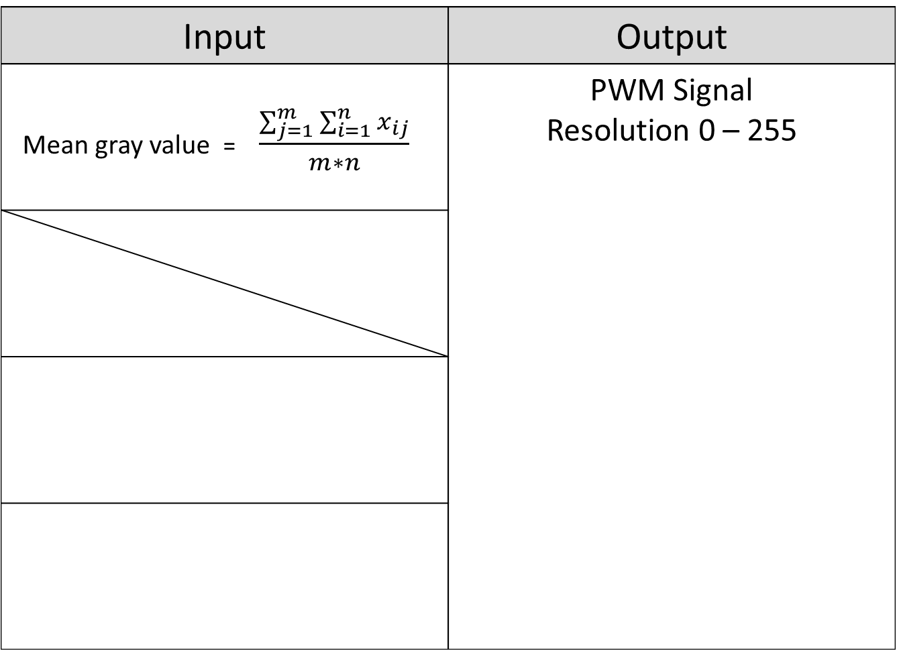
Input & Output of the System
Input | Output
Mean gray value = $\frac{\sum_{j=1}^{m}{\sum_{i=1}^{n}{x_{ij}}}}{m∗n}$ | PWM Signal Resolution 0 – 255

Slide 7
Before fuzzification, the possible range of the input and output should be acquired.
Input
Fuzzification
Inference
Defuzzification
Output

Slide 8
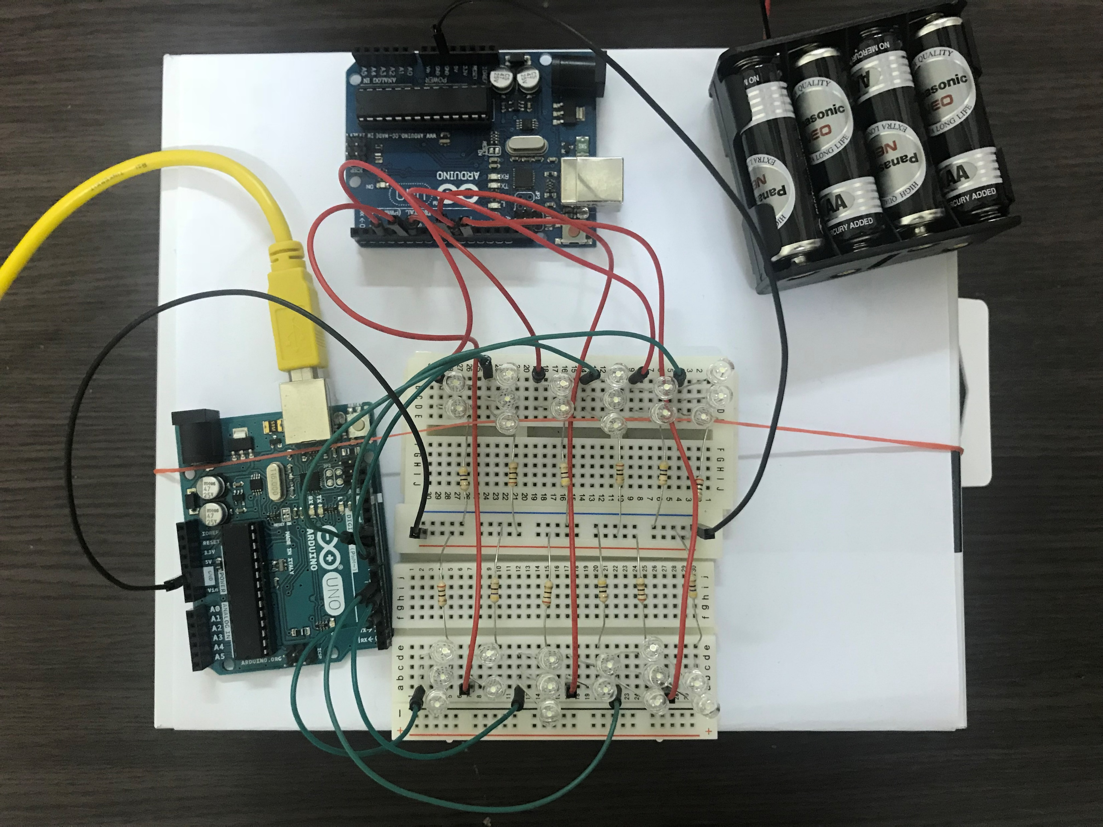
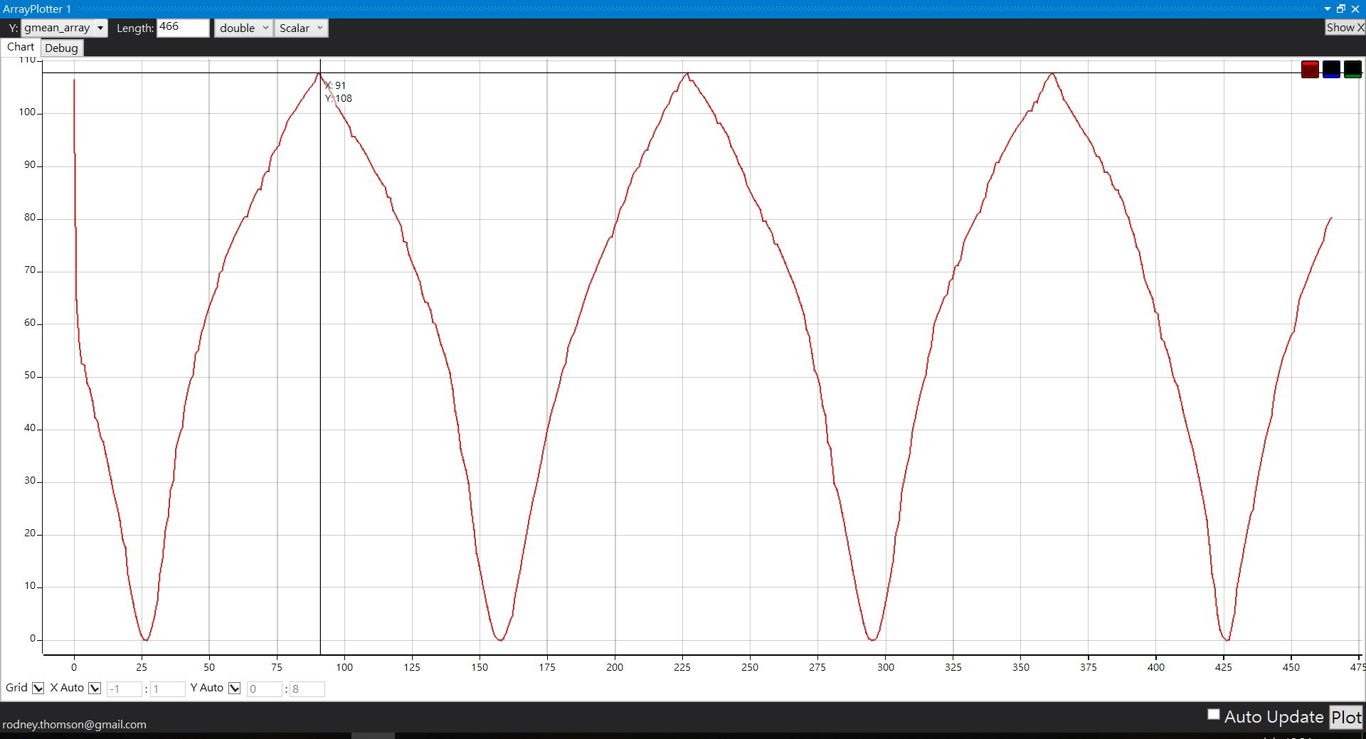
Environment test
Red: Environment
Green: Control
Environment:
PWM goes back and forth from 0 to 255.
For example:
Mean gray value

Slide 9
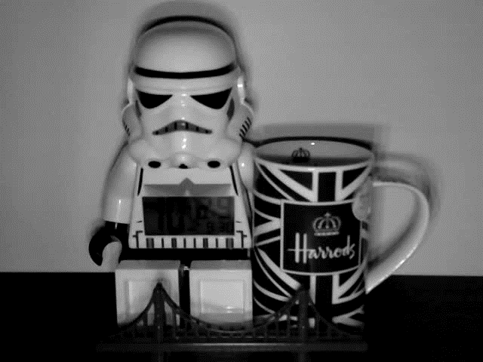
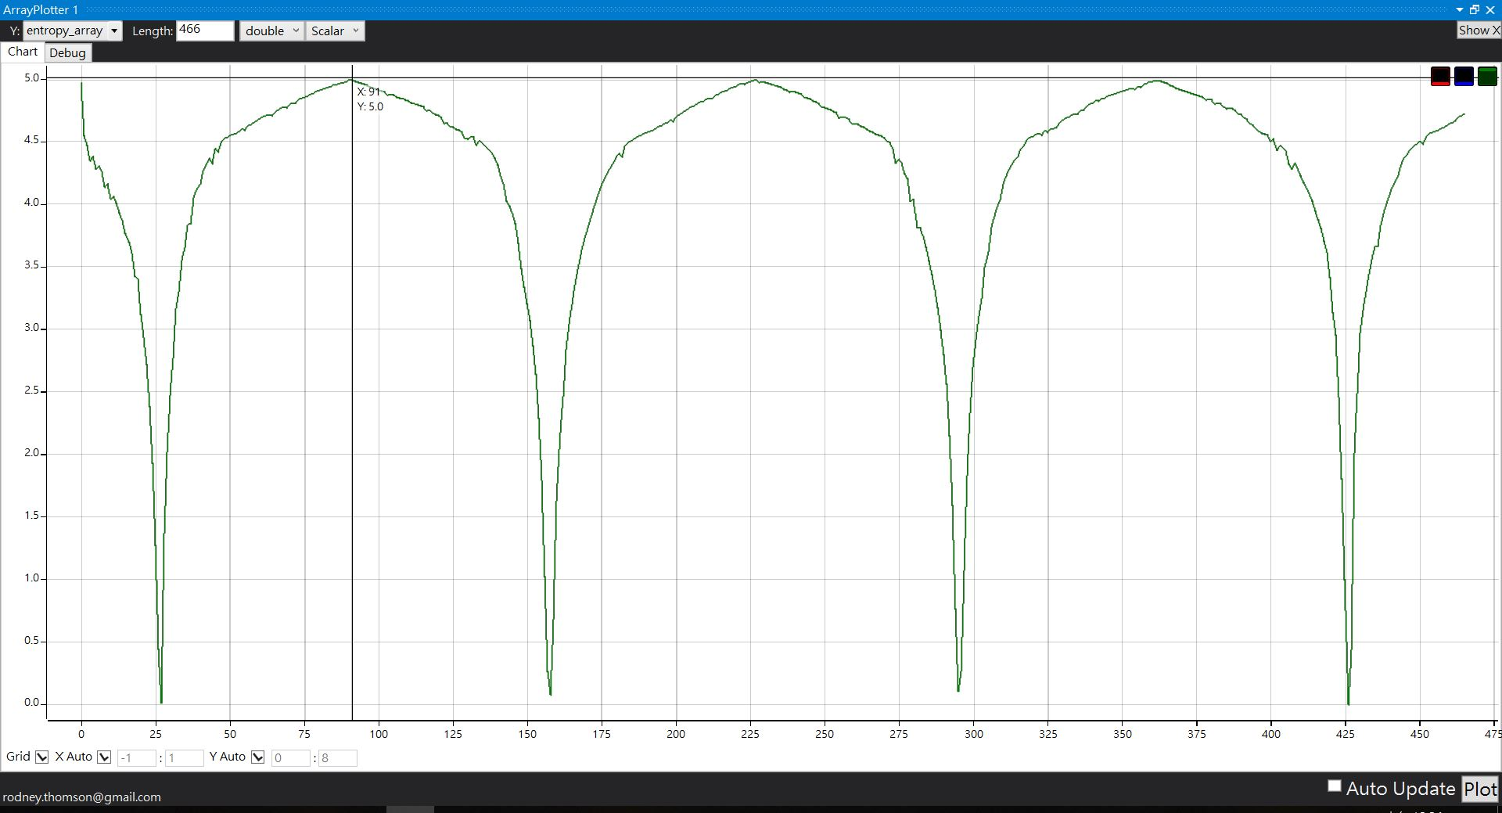
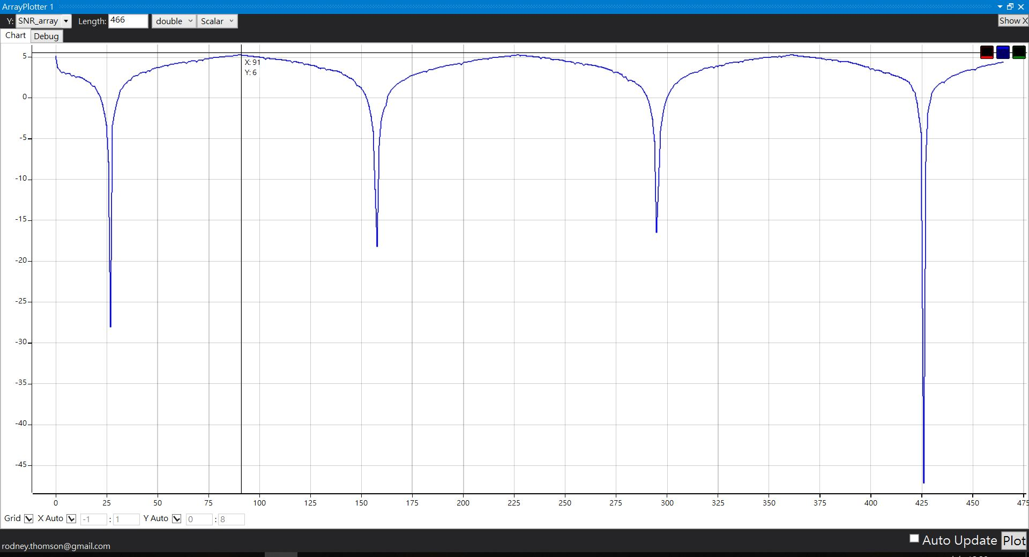
For better understanding
Environment:
PWM goes back and forth from 0 to 255.
Mean gray value
Entropy
SNR
The goal is to make the Input signal smooth even though environment is changing non-stop.

Slide 10
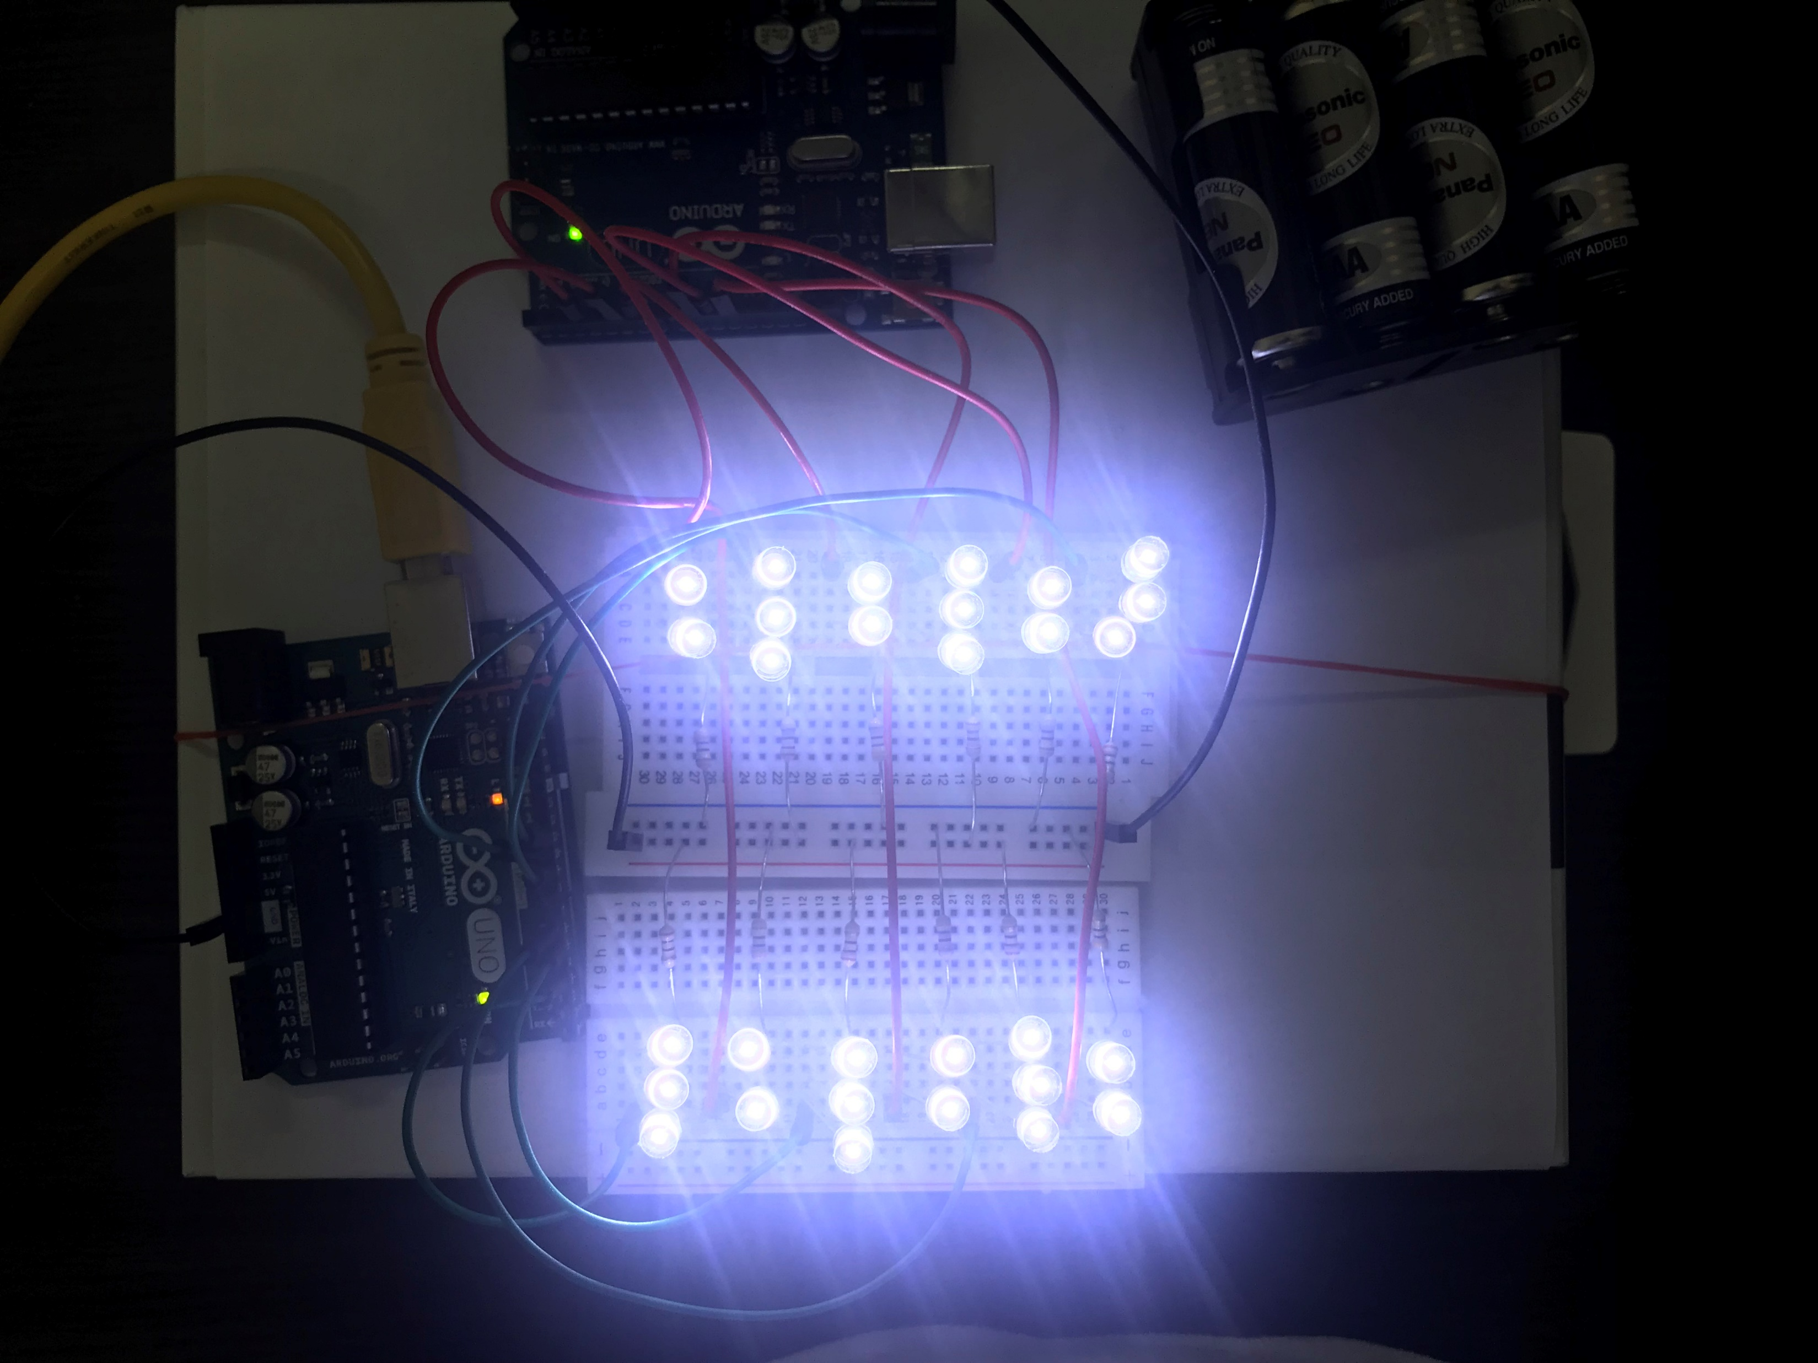
Upper boundary and lower boundary
Upper boundary:
Environment(When PWM=255) + Control(PWM=255)
Lower boundary:
Environment(When PWM=0) + Control(PWM=0)

Slide 11
Mathematically, The range of the boundary would be larger the possible.
 | Mean gray value | Entropy | SNR | Error | Error rate | PWM
Upper boundary | 164 | 5.22 | 6.53 | ? | ? | 255
Lower boundary | 0 | 0 | -48 | ? | ? | 0

Slide 12
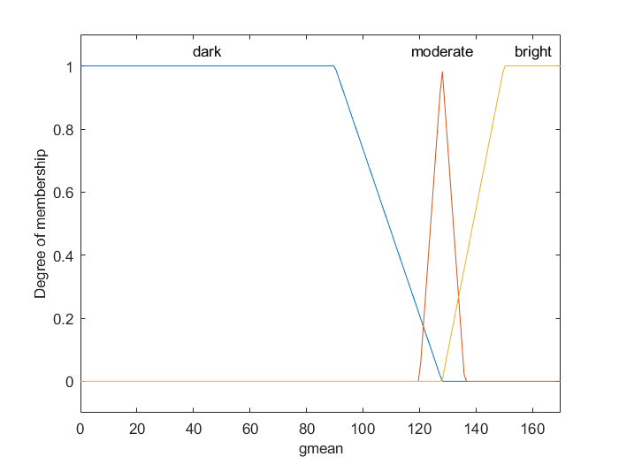
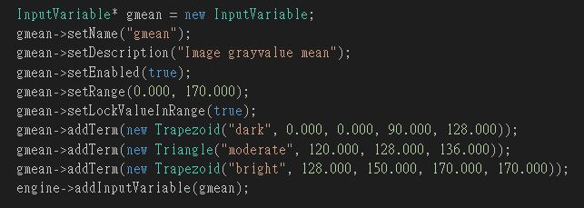
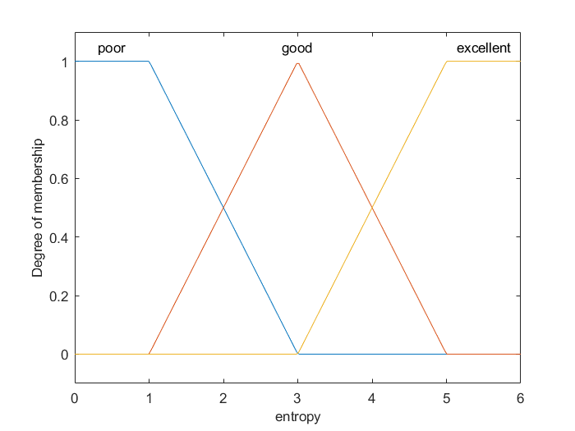
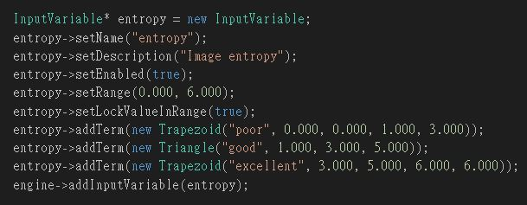
Mean gray value
Entropy

Slide 13
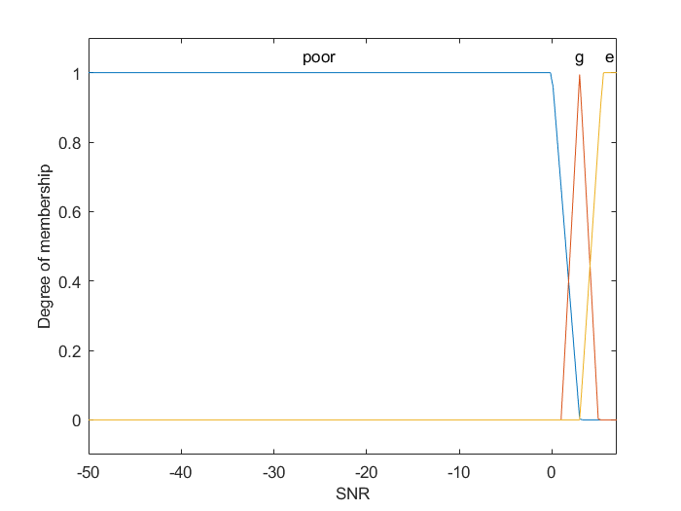
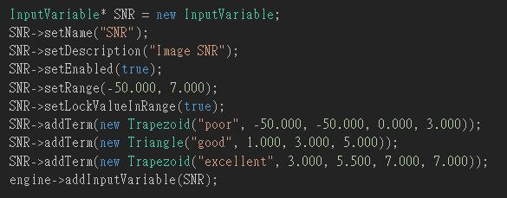
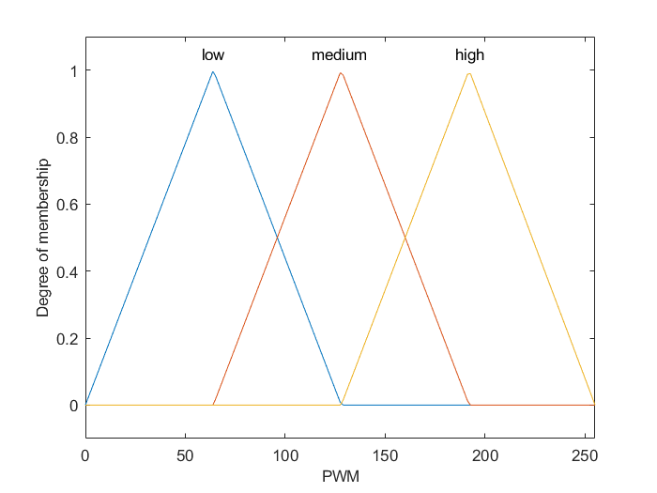
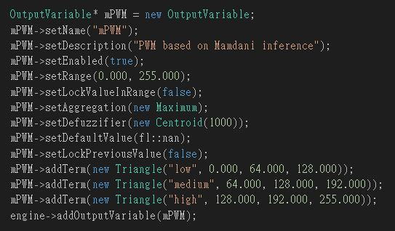
SNR
PWM

Slide 14
From intuition to PD like fuzzy controller
Input
Fuzzification
Inference
Defuzzification
Output

Slide 15
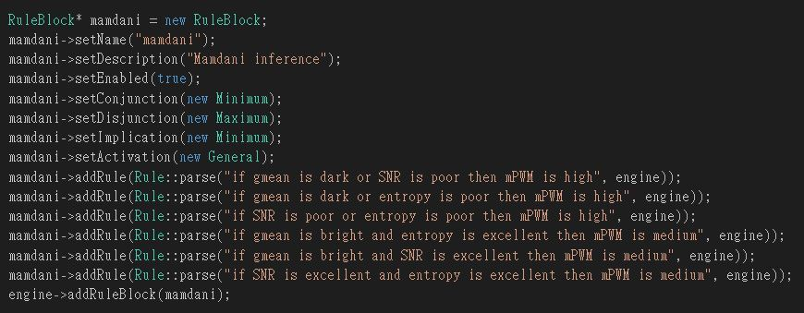
Inference based on intuition:
If gmean is dark or SNR is poor then PWM is high.
If gmean is dark or entropy is poor then PWM is high.
If SNR is poor or entropy is poor then PWM is high.
If gmean is bright and entropy is excellent then PWM is medium.
If gmean is bright and SNR is excellent then PWM is medium.
If SNR is excellent and entropy is excellent then PWM is medium.

Slide 16
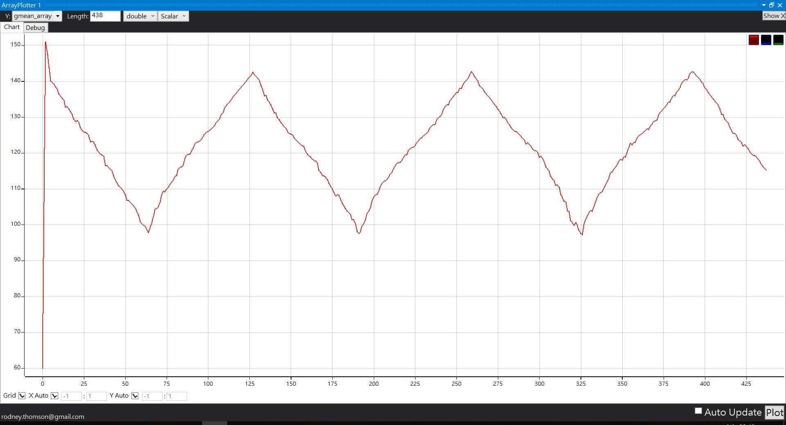
Inference based on intuition
Result is not good. Especially for mean gray value
Set point =128
Mean gray value
PD like fuzzy Inference

Slide 17
To implement the PD like fuzzy controller, the Error and the Error rate is computed.
 | Mean gray value | Entropy | SNR | Error | Error rate | PWM
Upper boundary | 164 | 5.22 | 6.53 | 40 | 5 | 255
Lower boundary | 0 | 0 | -48 | -20 | -5 | 0

Slide 18
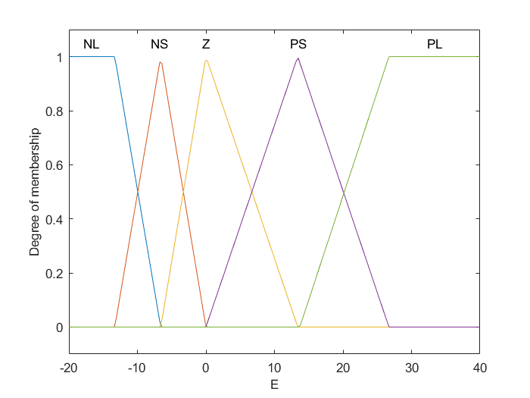
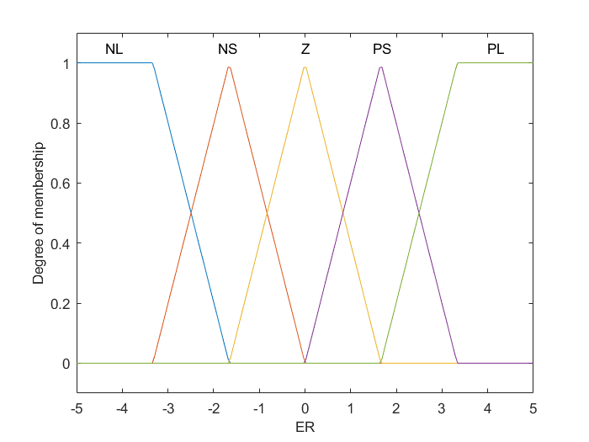
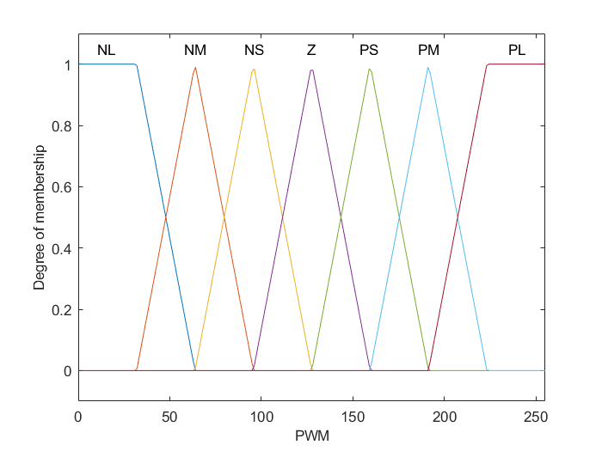
PWM
Error
Error rate

Slide 19
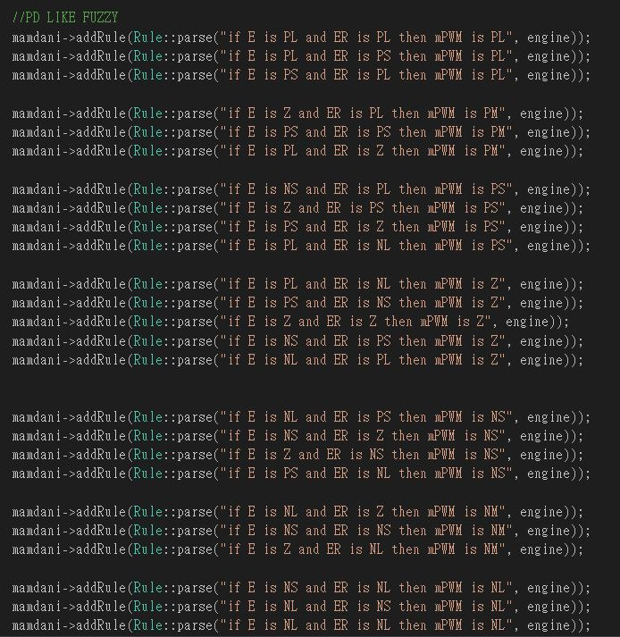
PD like fuzzy Inference:
 | NL | NS | Z | PS | PL
PL | Z | PS | PM | PL | PL
PS | NS | Z | PS | PM | PL
Z | NM | NS | Z | PS | PM
NS | NL | NM | NS | Z | PS
NL | NL | NL | NM | NS | Z
E
ER

Slide 20
Input
Fuzzification
Inference
Inference Method: Mamdani
Conjunction: Minimum
Disjunction: Maximum
Defuzzification Method: Centroid
Defuzzification
Output

Slide 21
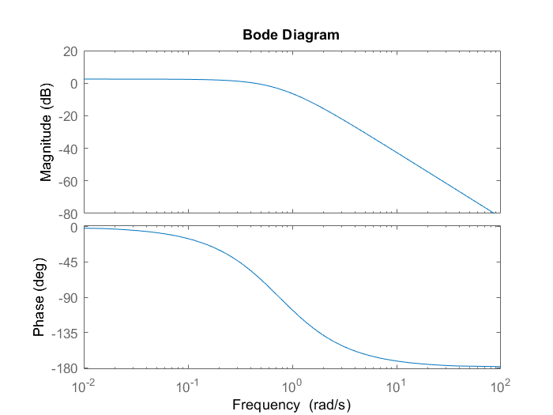
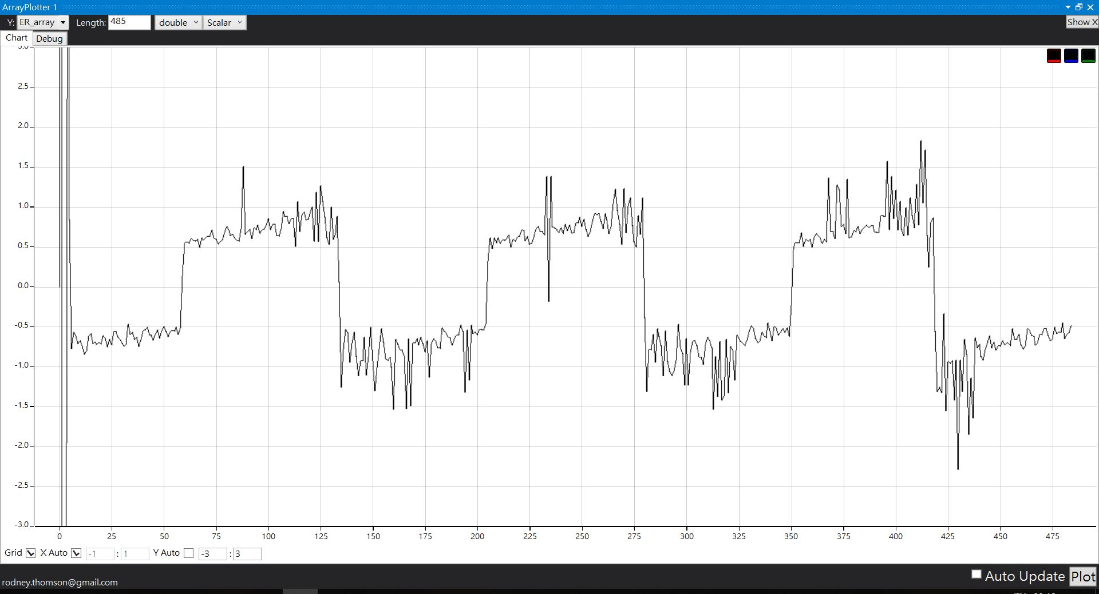
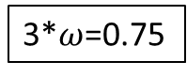
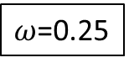
One more thing
Error rate
2nd order Low pass filter
Signal vibrate every 4 frames
$ω$=0.25
3*$ω$=0.75
ER
Filter
u(k) = $\frac{ω^{2}}{ω^{2}+2ω+1 }$ x ER + $\frac{2ω+2}{ω^{2}+2ω+1 }$ x u(k-1) - $\frac{1}{ω^{2}+2ω+1 }$ x u(k-2)

Slide 22
Input
Fuzzification
Inference
Defuzzification
Output

Slide 23
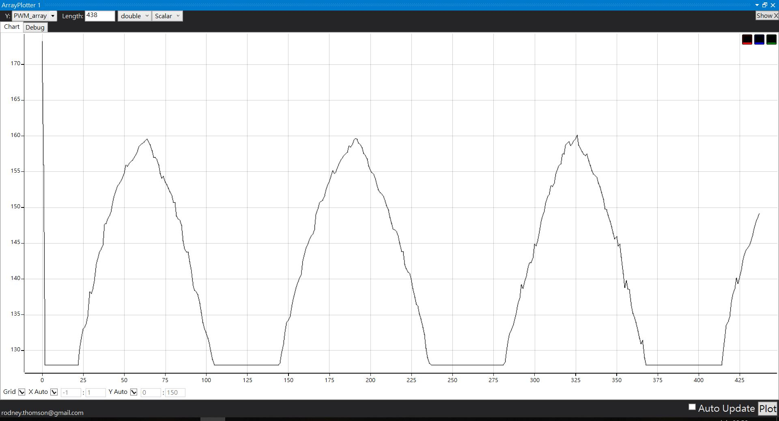
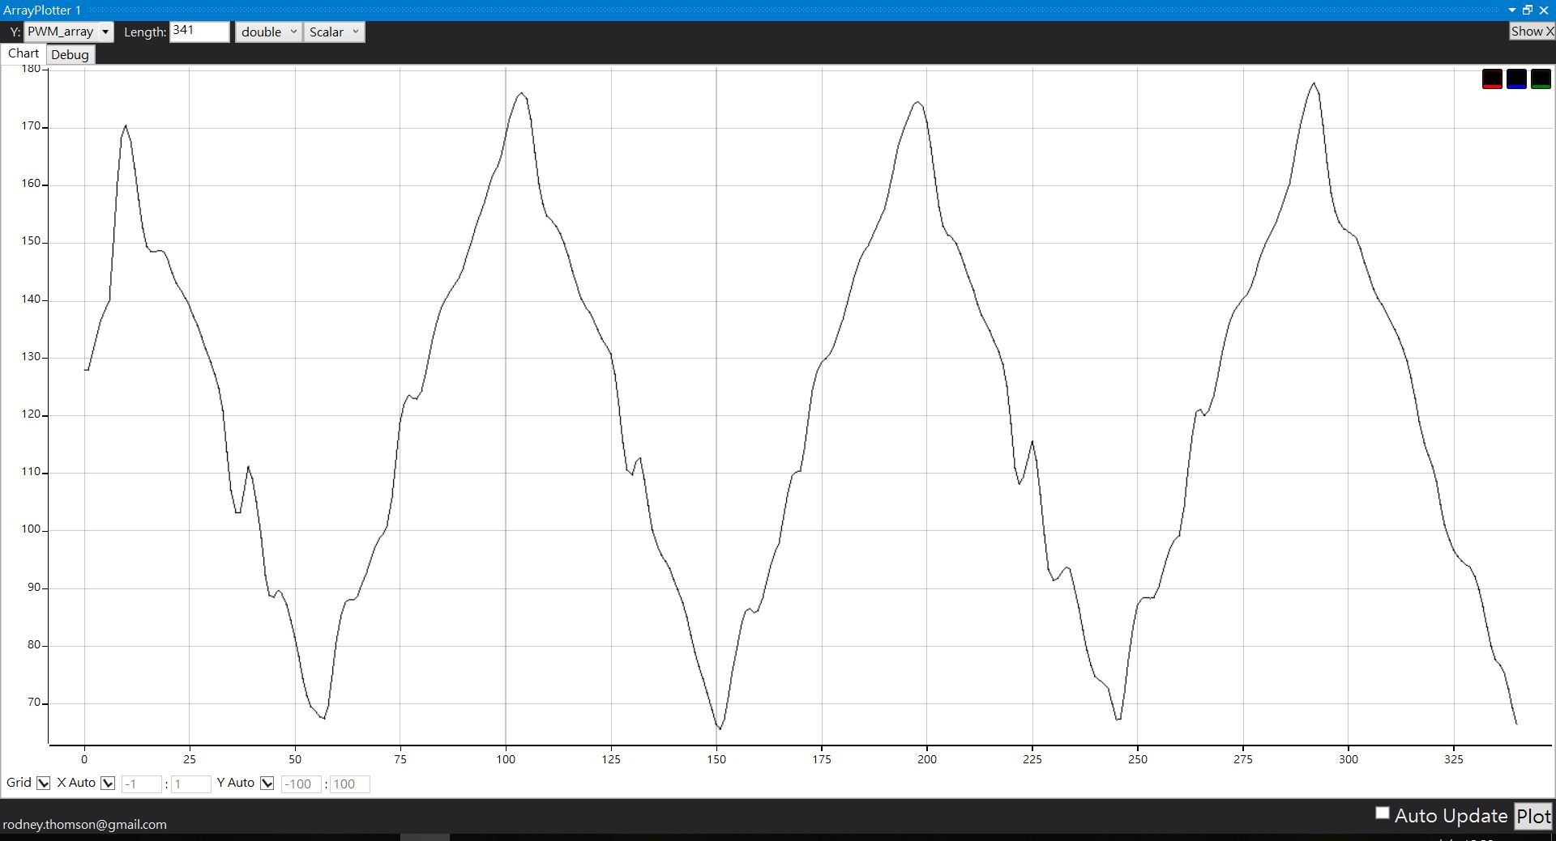
Controller Output PWM
Inference based on intuition
PD like fuzzy Inference
110
35

Slide 24
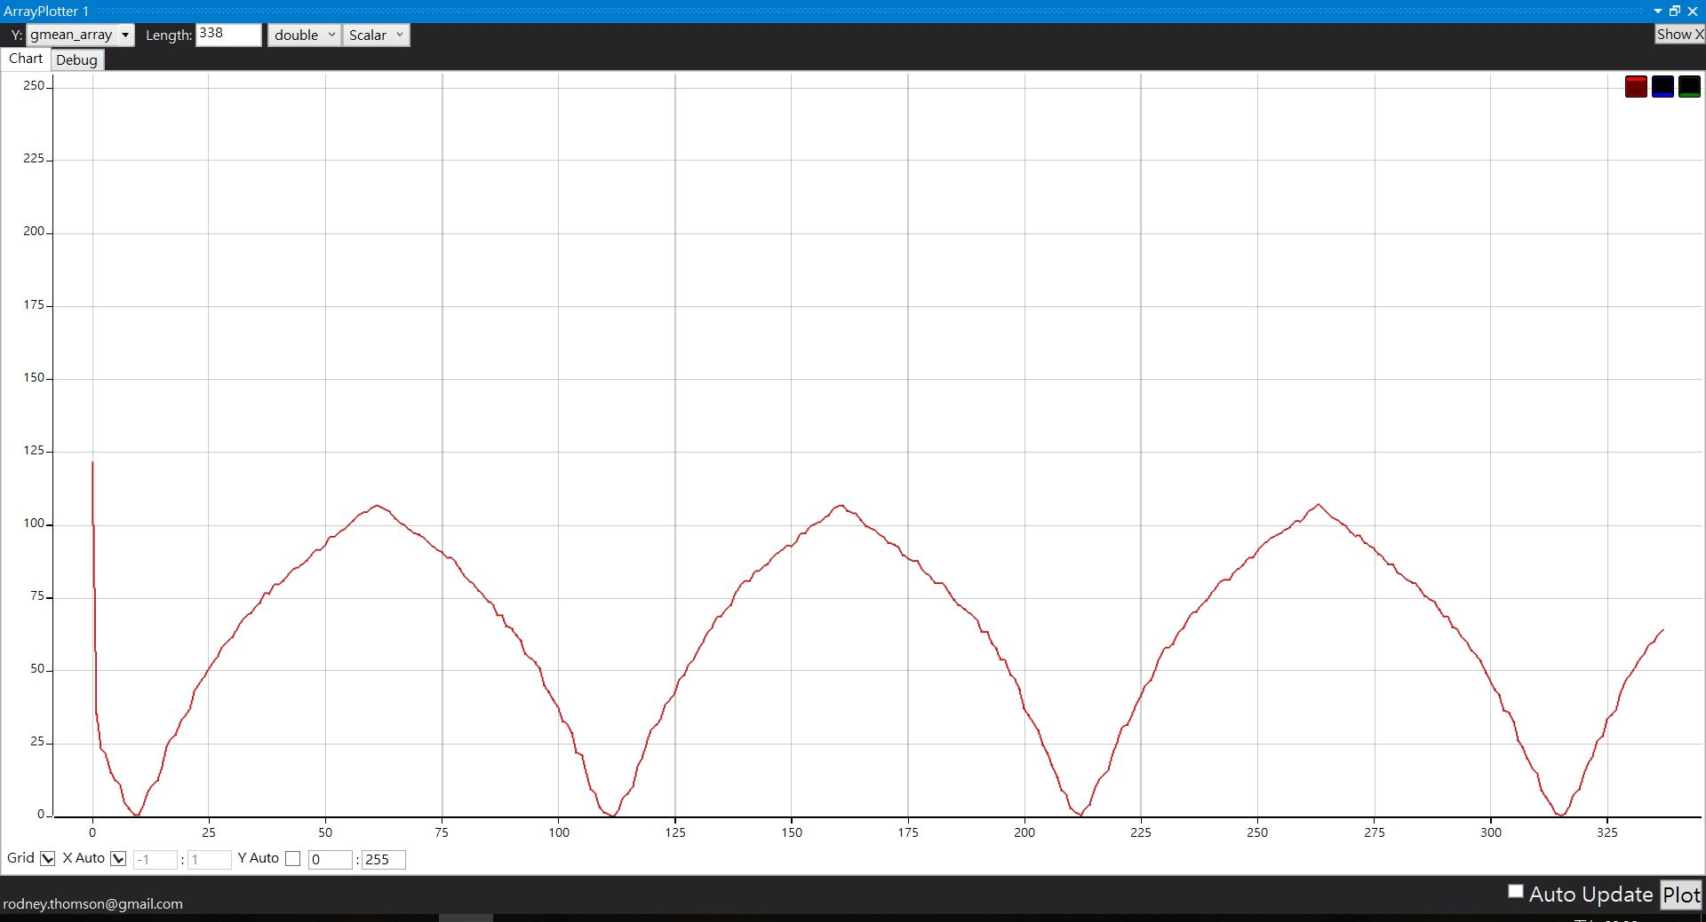
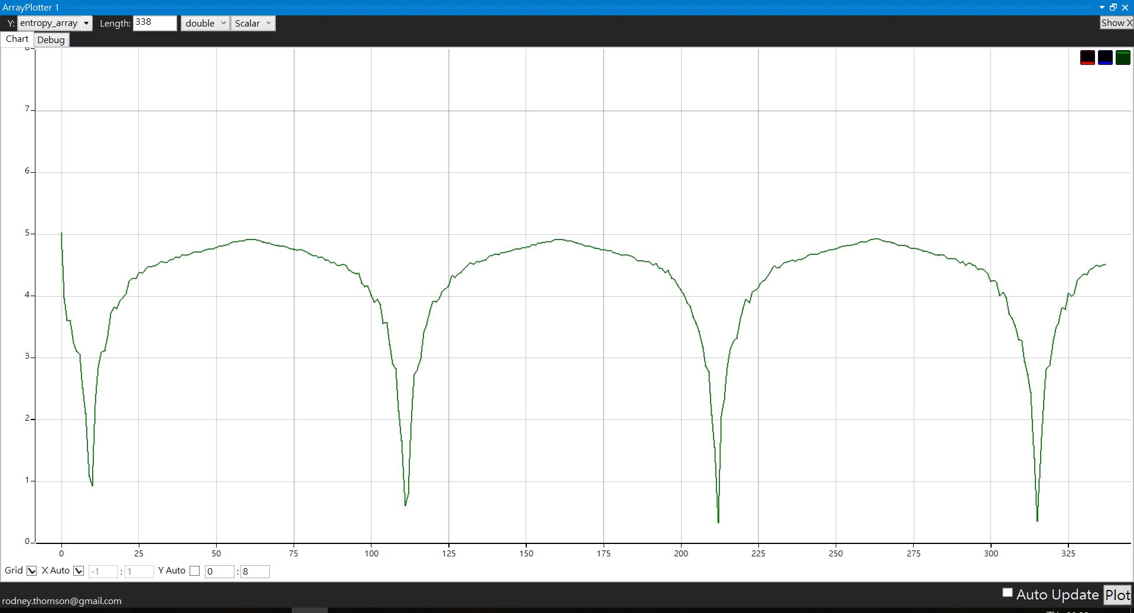
Result
Set point =128
Mean gray value
Without fuzzy controller
Entropy
SNR

Slide 25
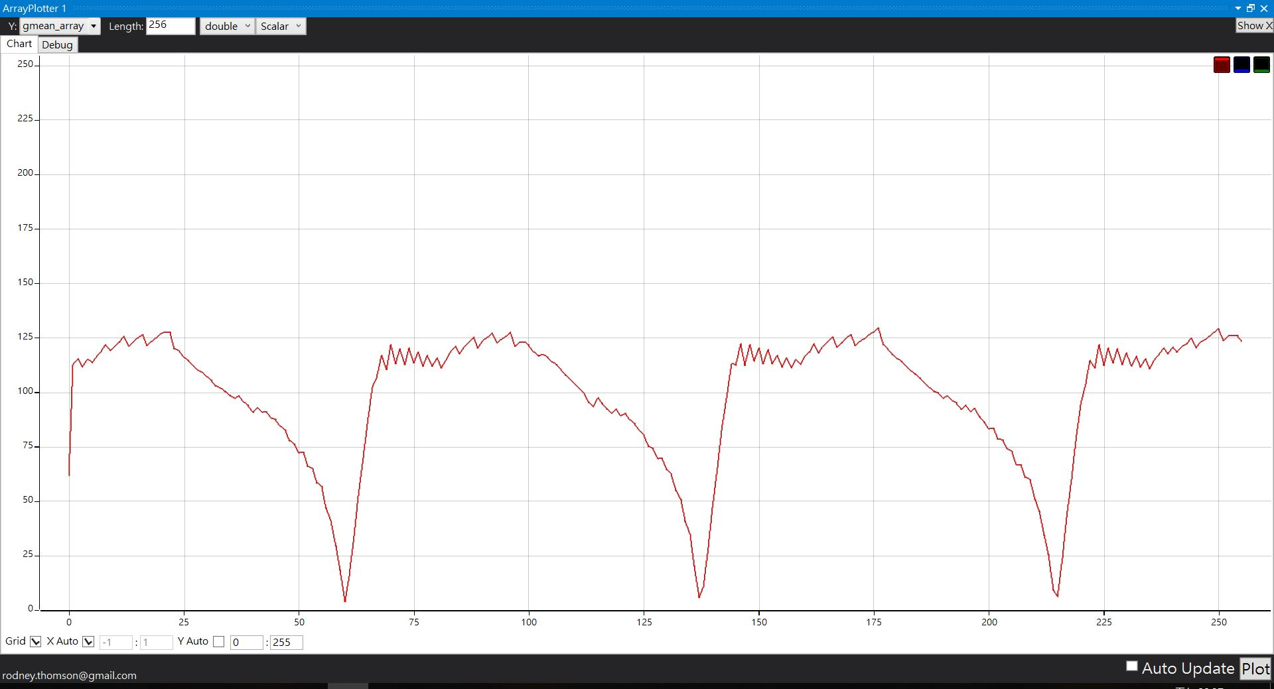
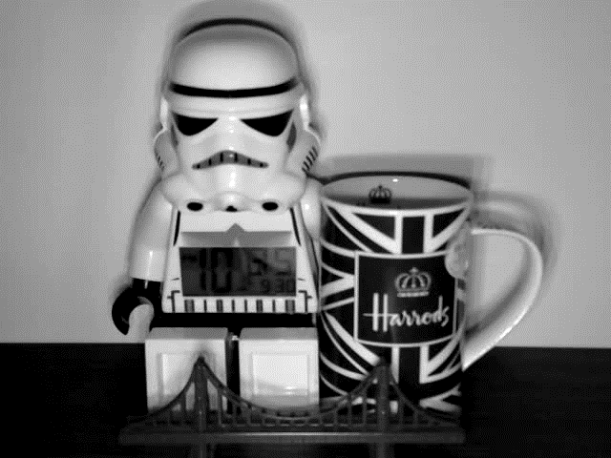
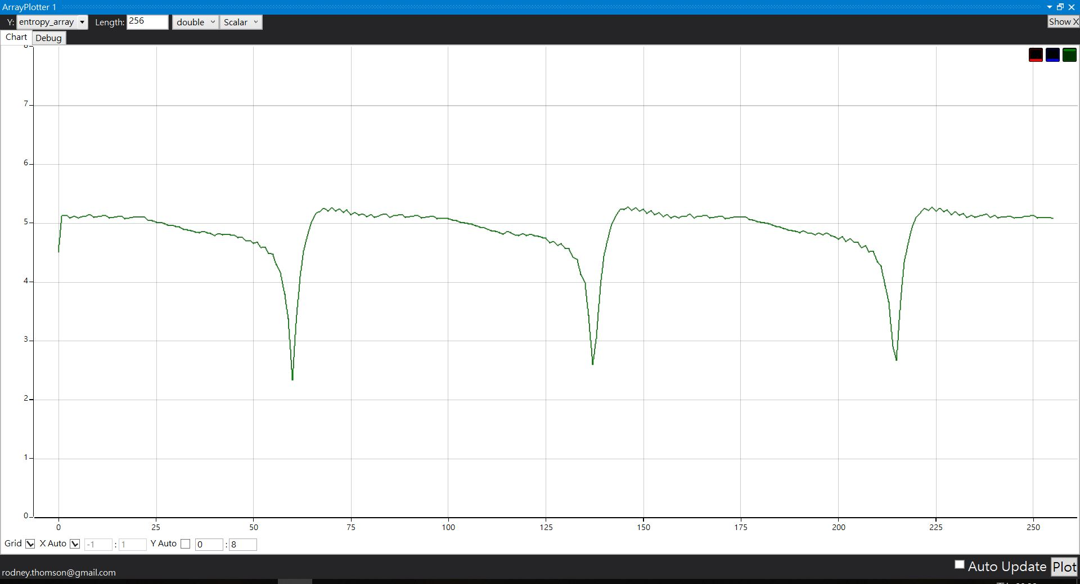
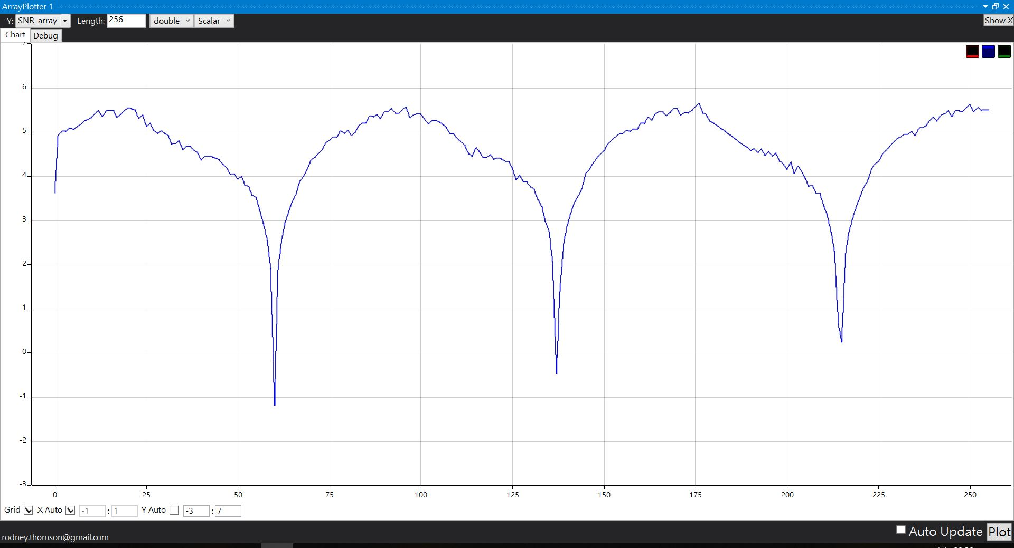
Set point =128
Mean gray value
Auto Exposure
Entropy
SNR

Slide 26
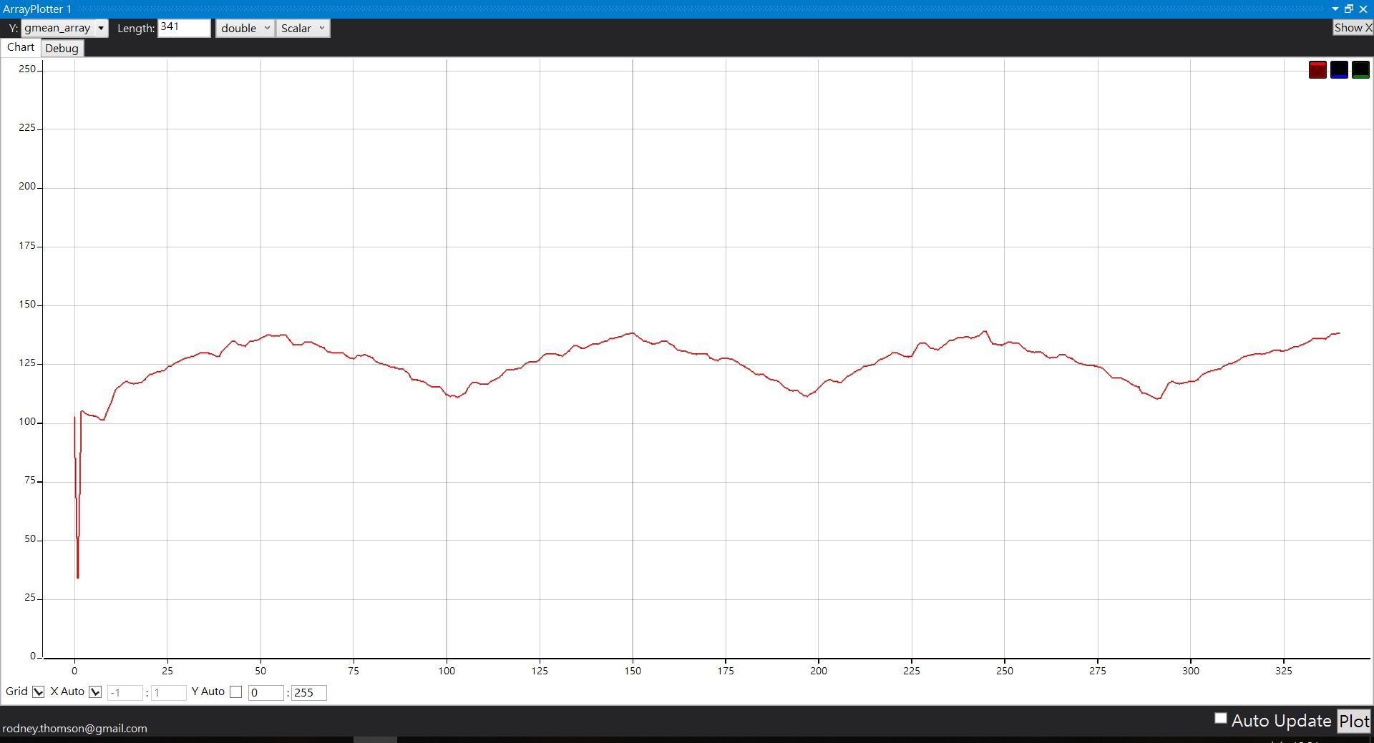
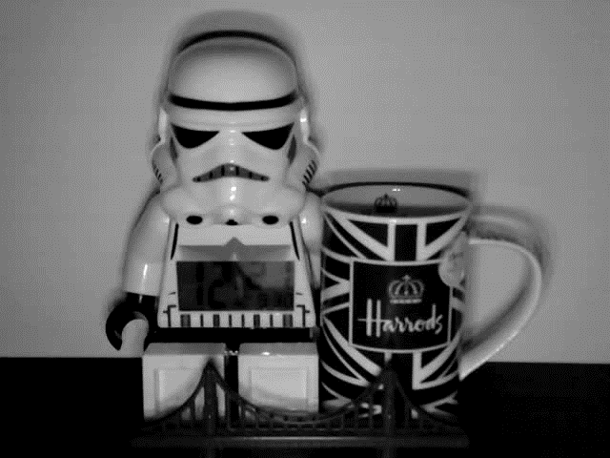
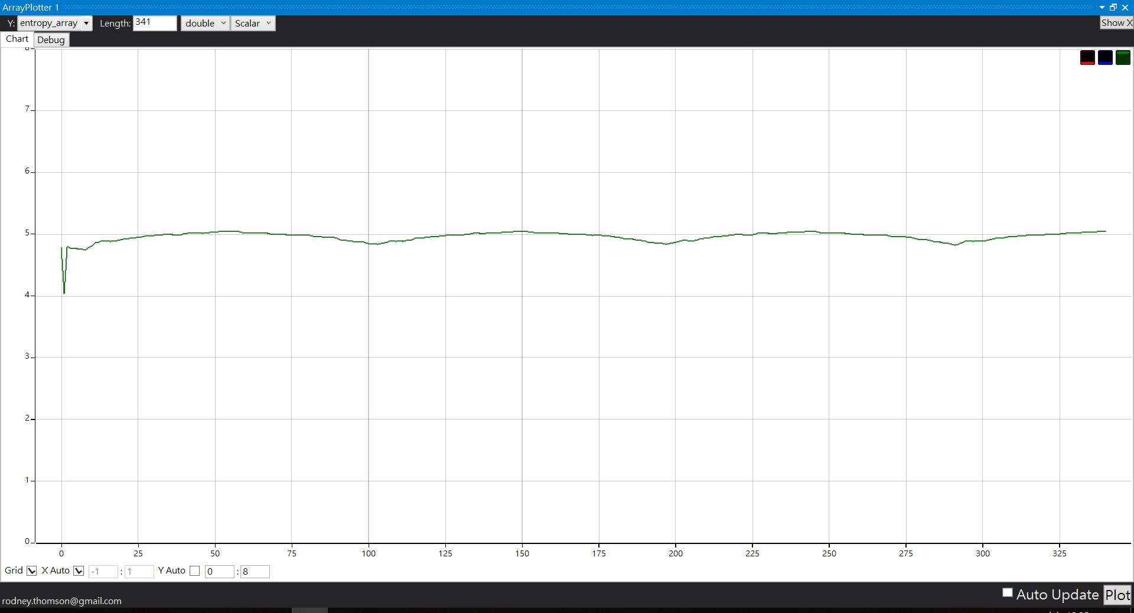
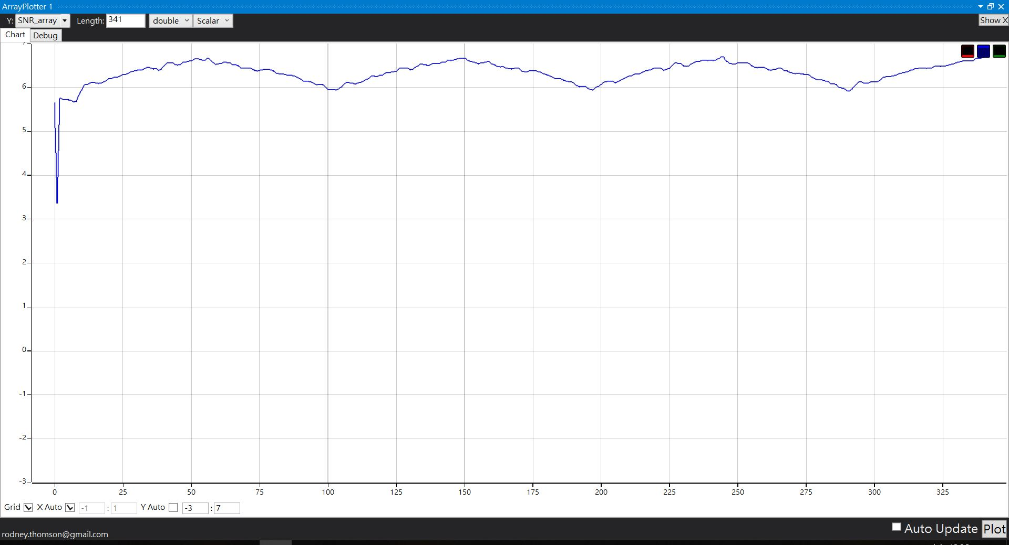
Set point =128
Mean gray value
Fuzzy controller
Entropy
SNR

Slide 27
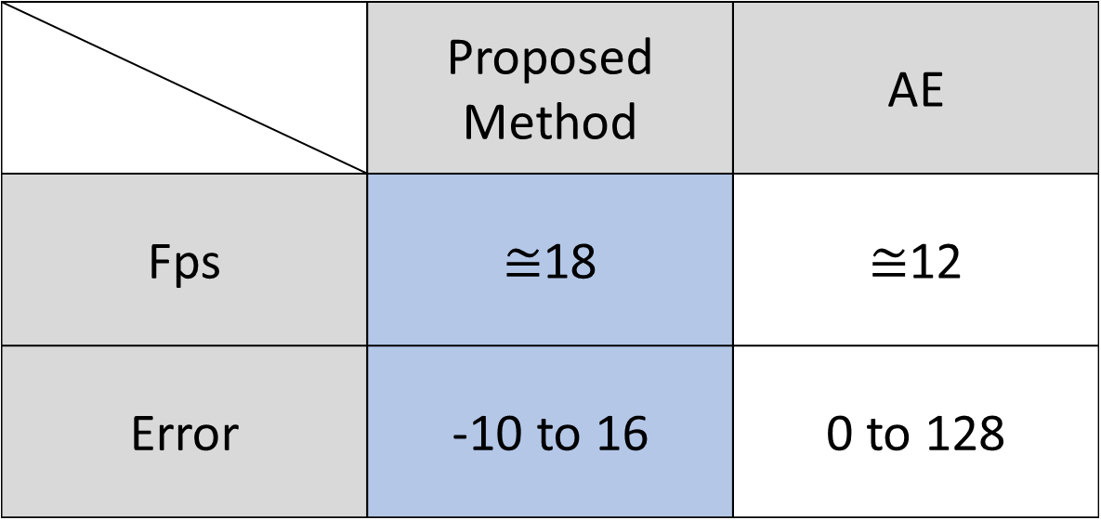
Conclusion
 | Proposed Method | AE
Fps | $≅$18 | $≅$12
Error | -10 to 16 | 0 to 128
Proposed Method is better than AE in low light situation.

